Slide 1

Session 7 – Python
Brief Intro to Machine Learning with Scikit Learn
Evaluating Accuracy of Regressors
Doug Bowman

Slide 2
Evaluating Accuracy of Regressors
Overview
  Mean Squared Error
  Coefficient of Determination (R²)
  Residuals Plot
  Prediction Error Plot

Slide 3
Evaluating Accuracy of Regressors
Mean Squared Error
  This represents a type of weighted average of the differences between predicted values and actual values.
  This is a measure of how far off the predicted values are from the actual values.
  The lower the value, the better.

Slide 4
Evaluating Accuracy of Regressors
Mean Squared Error
    M is the number of samples
    Y_{predict} = w₁*f₁ + w₂*f₂ + w₃*f₃ + … + w_{n}*f_{n} + b + r
      Y_{predict} = predicted value for a given sample
      w = weights
      f = feature value
      n = number of features
      b = intercept of linear line
      r = regularization parameter

Slide 5
Evaluating Accuracy of Regressors
Coefficient of Determination (R²)
  Measure of the percentage of variation in the output the input variable can account for.
  A score of 1 means that the inputs can predict 100% of the output.
  This is a measure of goodness of fit of our model.

Slide 6
Evaluating Accuracy of Regressors
Coefficient of Determination (R²)
  Usually, you want this value to be in the 0.90 range or above.

Slide 7
Evaluating Accuracy of Regressors
Residuals Plot
  Residual is the difference between the predicted value and the actual value.
  This plot is just the residuals vs the actual values.

Slide 8
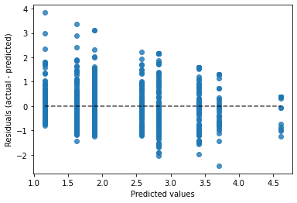
Evaluating Accuracy of Regressors
Residuals Plot

Slide 9
Evaluating Accuracy of Regressors
Prediction Error Plot
  This is just a simple plot of the predicted targets vs the actual targets.

Slide 10
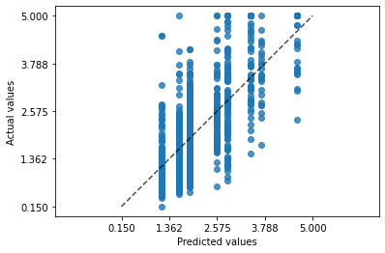
Evaluating Accuracy of Regressors
Prediction Error Plot

Slide 11
Evaluating Accuracy of Regressors
Go over in-class example code

Slide 12

Evaluating Accuracy of Regressors
In-Class Exercise
  With the data of your choice, build a regressor and show the following:
    Calculate the mean squared error
    Calculate the coefficient of determination
    Display the residuals vs actual values in a plot
    Display the predicted values vs actual values in a plot

Slide 13

Bibliography
https://github.com/amueller/introduction_to_ml_with_python/blob/master/02-supervised-learning.ipynb
Müller, A. C., & Guido, S. (2016). Introduction to Machine Learning with Python: A Guide for Data Scientists (1st ed.). O’Reilly Media.
http://rasbt.github.io/mlxtend/user_guide/general_concepts/gradient-optimization/

Slide 14
Bibliography
https://github.com/ageron/handson-ml
Géron Aurélien. Hands-on Machine Learning with Scikit-Learn and Tensorflow. 1st ed., O'Reilly, 2017.
https://machinelearningmastery.com/how-to-use-correlation-to-understand-the-relationship-between-variables/

Slide 15
Bibliography
Harrison, Matt. Machine Learning Pocket Reference: Working with Structured Data in Python. 1st ed., O'Reilly, 2019.
https://scikit-learn.org/stable/modules/cross_validation.html
Scikit-learn: Machine Learning in Python, Pedregosa et al., JMLR 12, pp. 2825-2830, 2011.

Slide 16
Bibliography
API design for machine learning software: experiences from the scikit-learn project, Buitinck et al., 2013.
https://docs.scipy.org/doc/scipy/reference/generated/scipy.stats.pearsonr.html
https://docs.scipy.org/doc/scipy/reference/generated/scipy.stats.spearmanr.html#scipy.stats.spearmanr

Slide 17
Bibliography
https://www.investopedia.com/terms/p/p-value.asp
https://scikit-learn.org/stable/auto_examples/manifold/plot_swissroll.html#sphx-glr-auto-examples-manifold-plot-swissroll-py
https://scikit-learn.org/stable/auto_examples/manifold/plot_compare_methods.html#sphx-glr-auto-examples-manifold-plot-compare-methods-py

Slide 18
Bibliography
16) https://wizardforcel.gitbooks.io/scikit-and-tensorflow-workbooks-bjpcjp/content/ch08-dimensionality-reduction.html
17) https://pub.towardsai.net/principal-component-analysis-in-dimensionality-reduction-with-python-1a613006d531
18) https://towardsdatascience.com/the-kernel-trick-c98cdbcaeb3f

Slide 19
Bibliography
19) https://cs.nyu.edu/~roweis/lle/papers/lleintro.pdf
20)https://docs.python.org/3/library/json.html
21)https://academic.oup.com/bioinformatics/article/24/18/2010/190849?login=false
22)https://arxiv.org/pdf/1904.10416.pdf
23)

Slide 20
Additional Resources
https://towardsdatascience.com/over-fitting-and-regularization-64d16100f45c
https://towardsdatascience.com/scale-standardize-or-normalize-with-scikit-learn-6ccc7d176a02

Slide 21
LICENSE
Copyright 2022 Douglas Bowman
Permission is hereby granted, free of charge, to any person obtaining a copy of this software and associated documentation files (the "Software"), to deal in the Software without restriction, including without limitation the rights to use, copy, modify, merge, publish, distribute, sublicense, and/or sell copies of the Software, and to permit persons to whom the Software is furnished to do so, subject to the following conditions:
The above copyright notice and this permission notice shall be included in all copies or substantial portions of the Software.
THE SOFTWARE IS PROVIDED "AS IS", WITHOUT WARRANTY OF ANY KIND, EXPRESS OR IMPLIED, INCLUDING BUT NOT LIMITED TO THE WARRANTIES OF MERCHANTABILITY, FITNESS FOR A PARTICULAR PURPOSE AND NONINFRINGEMENT. IN NO EVENT SHALL THE AUTHORS OR COPYRIGHT HOLDERS BE LIABLE FOR ANY CLAIM, DAMAGES OR OTHER LIABILITY, WHETHER IN AN ACTION OF CONTRACT, TORT OR OTHERWISE, ARISING FROM, OUT OF OR IN CONNECTION WITH THE SOFTWARE OR THE USE OR OTHER DEALINGS IN THE SOFTWARE.

